Slide 1


GIT Assignment
TOPIC: ADD
Presented By : Shubham Gupta
Employee ID : 1640

Slide 2
What is Git ?
GIT is a version controlled system which you can use to maintain code for your project.
GIT is a free and open source distributed version control system designed to handle everything from small to large projects with speed and efficiency.
You check out the files from a version, make some changes, save it and commit changes to create a newer version of your project.

Slide 3
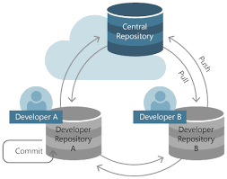
What is a Repository ?
“repo” = repository
Usually used to organize a single project.
repos can contain folders and files, images, videos, spreadsheets, and data sets – anything your project needs.

Slide 4
BASIC GIT COMMANDS
git add - is a command used to add a file that is in the working directory to the staging area.
git commit - is a command used to add all files that are staged to the local repository.
git push - is a command used to add all committed files in the local repository to the remote repository. So in the remote repository, all files and changes will be visible to anyone with access to the remote repository.
git fetch - is a command used to get files from the remote repository to the local repository but not into the working directory.
git merge - is a command used to get the files from the local repository into the working directory.
git pull - is command used to get files from the remote repository directly into the working directory. It is equivalent to a git fetch and a git merge .

Slide 5


ADD Commands
The git add command adds a file or folder to the staging area. Files in the staging area are those that you want to add to your next commit. Git add does not modify or otherwise affect your repository or files.
The Git Version Control System does not have a simple save feature. Git uses a process called committing. This is where you create a record of all the changes made to flies since the last commit.
This process involves a few different command line operations. The first step is saving file or folder changes to a Git repository is to use the git add command. This command lets you select which file you want to commit to a repository by moving the directory to the staging area.

Slide 6
Steps for changing a file or folder in a Git repository:
1. On your system, update a file or folder in the Git repository.
2. Use git add to add those changes to the staging area.
3.Use git command to move changes from the staging area to a commit.
4.Use git push to push those changes to the main repository. To save a file in Git, you need to use the git and git commit commands.

Slide 7
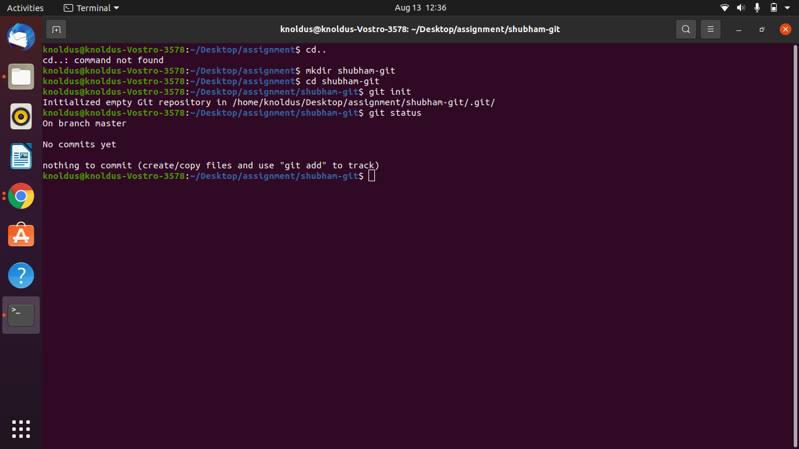
Steps Performed:
Step 1.

Slide 8
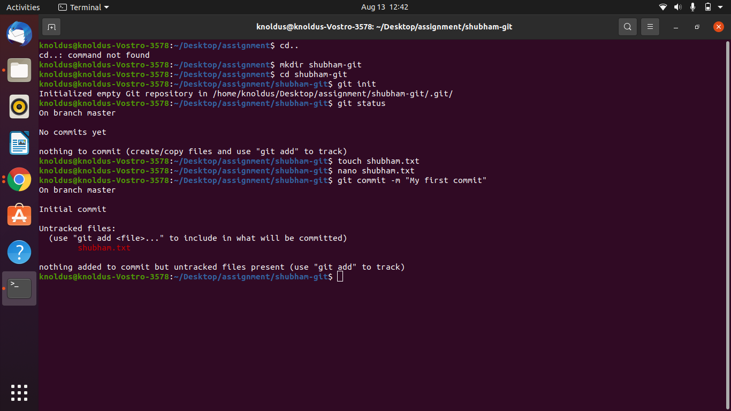
Steps Performed:
Step 2.

Slide 9
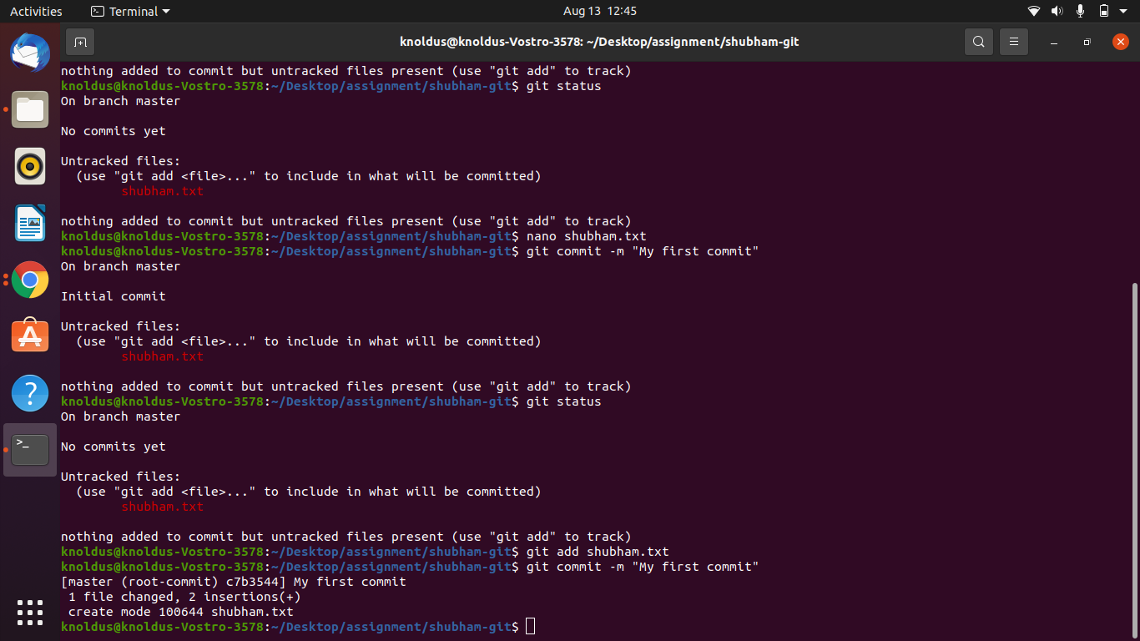
Steps Performed:
Step 3.

Slide 10
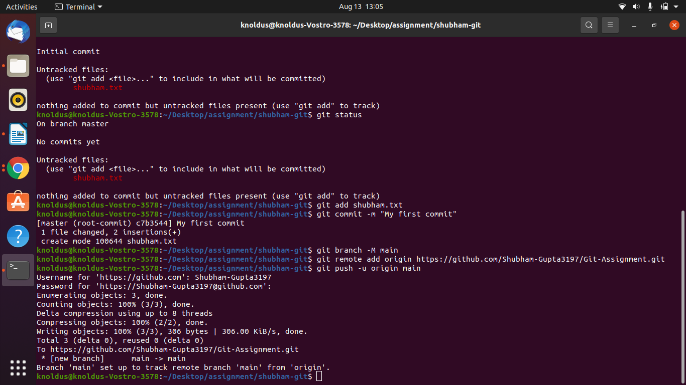
Steps Performed:
Step 4.

Slide 11
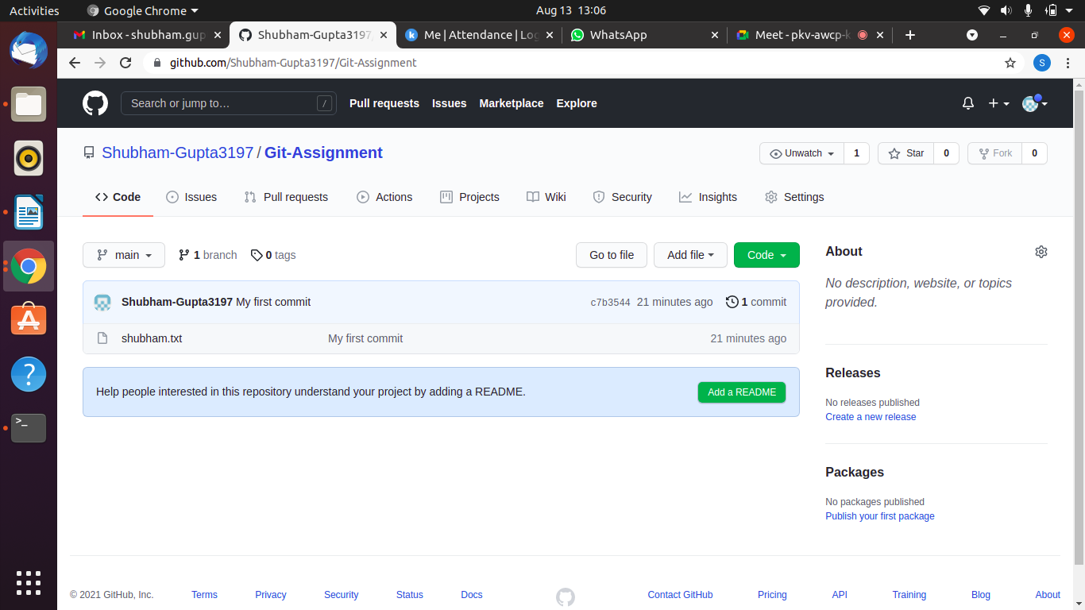
Steps Performed:
Step 5. Repository- https://github.com/Shubham-Gupta3197/Git-Assignment

Slide 12

GITHUB URL
https://github.com/Shubham-Gupta3197/Git-Assignment

Slide 13
Thank You!
Stay in Touch
facebook.com/templateparade
@Temparade
Boulevard of Good Dream, 89898
+6288 2546 0845

